Slide 1





Data Team Presentation
Monorepo in GitHub for Code Management and Collaboration
Unified Workflow with uv Python Package Manager
Streamlining our data workflow with a unified codebase
Simplified dependency management
Enhanced team collaboration
Accelerated development cycle
GitHub Monorepo Solution
apps/
packages/
docs/
scripts/
November 5, 2025
pyproject.toml
uv.lock

Slide 2










Current Challenges in Our Data Team
Our team navigates a landscape of scattered code across numerous repositories, facing several operational challenges
Scattered Code
Dependency Conflicts
Code distributed across numerous repositories, making it difficult to understand the full system
Version mismatches and conflicts between dependencies causing integration issues
Inconsistent Tooling
Duplicated Efforts
Different teams using different tools and workflows, leading to fragmented expertise
Multiple teams reimplementing similar solutions, wasting time and resources
Impact: Slower development cycles, increased onboarding time, and reduced collaboration
2 / 13

Slide 3















What is a Monorepo?
A version-controlled code repository hosting multiple distinct projects under a single roof
Monorepo Definition
A monorepo is a version-controlled code repository that hosts multiple distinct projects or an entire full-stack codebase under a single roof. This approach contrasts with a "polyrepo" structure, where each project, application, or service resides in its own separate repository.
Monorepo
Polyrepo
project-a/
project-a/
project-b/
project-b/
project-c/
project-c/
Projects share unified version control
Each project has independent version control
Consistent tooling across projects
Tooling may vary between projects
Dependencies can be shared between projects
Dependency management between projects is complex
3 / 13

Slide 4


















Why Monorepo Matters for Data Teams
Adopting a monorepo offers significant advantages for data teams, streamlining workflows and enhancing collaboration
Centralized Tooling
Simplified Workflow
Reduced Duplication
Streamlined Collaboration
Consolidates tooling efforts, simplifying improvements across all data projects
Provides a single entry point for most tasks, reducing context switching
Facilitates creation and reuse of shared modules for common operations
Improves visibility across projects and fosters knowledge sharing
Dependency Management
Easier Onboarding
Consistent Data Interfaces
Unified CI/CD
New members access entire data ecosystem from a single repository
Allows for unified pipelines for testing and deploying data models
Eliminates version mismatches between shared components
Encourages standardized schemas and data access patterns
4 / 13

Slide 5














Common Misconceptions About Monorepos
Addressing performance and complexity fears with modern tooling solutions
Common Concerns
Modern Solutions
Slow Performance
Blazing Fast Builds
Large repositories impact build times and developer experience
Tools detect affected projects and only process relevant code
Smart Caching
Increased Complexity
Local and distributed computation caching prevents redundant work
Managing dependencies and builds across many projects
Version Conflicts
Specialized Tooling
Difficulty tracking dependency versions across projects
Bazel, Nx, and Turborepo designed specifically to manage monorepo complexity
Even Google uses monorepos (80 TB!) with these tools to maintain efficiency and consistency across teams
5 / 13

Slide 6









Proposed Data Monorepo Structure
A clear and hierarchical folder organization for effective project management
# Monorepo Root
apps/ Data Applications
apps/
Contains specific data applications or dashboards
# Specific data applications or dashboards
├── sales-dashboard/
├── fraud-detection-model/
└── customer-segmentation/
packages/ Shared Code
packages/
# Shared code for data access
Hosts shared modules for data access, feature engineering, and ML components
├── data-access-layer/
# Reusable feature generation logic
├── feature-engineering/
# General utility functions
├── common-utils/
└── ml-base-models/
docs/, scripts/, .github/
Standard directories for documentation, scripts, and CI/CD workflows
docs/
scripts/
.github/
└── workflows/
This structure promotes organization, discoverability, and consistent practices across the team
6 / 13

Slide 7













Smart CI/CD with GitHub Actions
Optimizing our development workflow with targeted executions
Path Filtering
Matrix Builds
Reusable Workflows
Triggers workflows only for relevant code changes
Runs jobs in parallel across configurations
Encapsulates common CI/CD patterns
Example: Path Filtering
Key Benefits
Configure workflows to trigger only for specific paths:
Reduced build times
on:
push:
paths:
- 'apps/sales-dashboard/**'
- 'packages/data-access-layer/**'
pull_request:
paths:
- 'apps/sales-dashboard/**'
Optimized resource usage
7 / 13

Slide 8
















Monorepo Tooling Comparison
Evaluating Nx versus Turborepo for managing our data monorepo
Nx
Turborepo
Developed by Nrwl
Developed by Vercel
Deep integration with Angular and JS ecosystem
Focus on performance and caching
Matured over many years
Becoming de facto standard for JS ecosystem
Best for:
Best for:
Projects with strong Angular/JavaScript dependencies
Performance-critical projects with complex builds
Both tools offer powerful features for monorepo management, with Nx having deeper integration into the JavaScript ecosystem and Turborepo focusing on performance and caching.
8 / 13

Slide 9












Introducing uv - Modern Python Package Manager
Rust-powered unified tooling for Python development
Replaces Traditional Tools
What is uv?
pip
virtualenv
Modern, extremely fast Python package manager
Package installation and management
Virtual environment management
Developed by Astral, written in Rust
Unifies multiple traditional Python tools
poetry
pip-tools
Dependency management and packaging
Transitive dependency resolution
Core Design Goals
Superior Performance
Unified Tooling
Broad Compatibility
pip install uv
One tool, one interface, maximum efficiency
9 / 13

Slide 10



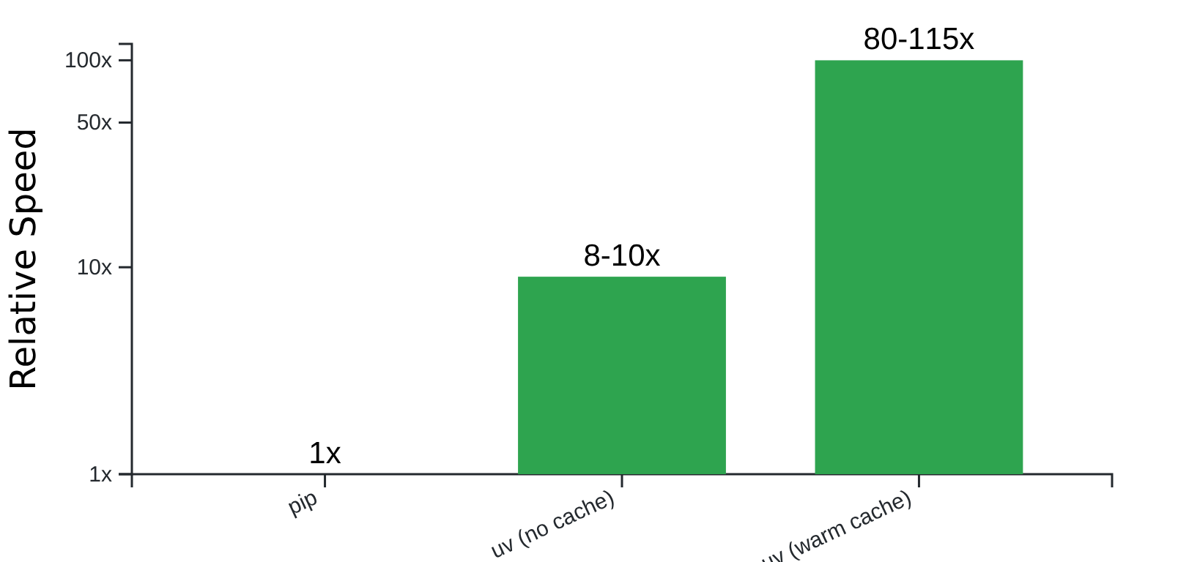







The uv Advantage
Why modern Python development requires a faster, unified approach
Blazing Speed
Performance Comparison
8-10x faster than pip without cache, up to 80-115x faster with warm cache
Unified Tooling
Consolidates package management, virtual environments, Python versions, and more
Simplified Workflows
Automatic virtual environment management and robust lockfiles
*Based on real-world benchmarks
uv = pip + pip-tools + virtualenv + parts of poetry
10 / 13

Slide 11




























uv vs Current Tools Comparison
Evaluating performance, dependency resolution, lockfile support, and environment handling
Feature/Aspect
pip & venv
Poetry
uv
Speed
8x-100x faster (Rust-based resolver)
Moderate/Slow
Moderate
Dependency Resolution
Advanced solver, slower on large graphs
Advanced, parallel, optimized, deterministic
Basic, sequential
Lockfile Support
Robust uv.lock & universal lockfiles
pip freeze (weak locking)
Strong lock via poetry.lock
Virtual Environment Handling
Manual with venv/virtualenv
Integrated & automatic
Integrated, very fast, seamless
Python Version Management
Built-in Python installer and versioning
External tool (pyenv)
Partial (external needed)
Key Takeaway: uv offers significant advantages in speed, dependency resolution, and unified tooling compared to traditional tools
11 / 13

Slide 12








Unified Workflow in Action
A real-world scenario demonstrating our integrated development cycle
1. Code Change
Data scientist modifies shared feature engineering library and ML model in a single PR
Integrated Development Cycle
Development
Shared codebase enables seamless collaboration
2. Automated Testing
GitHub Actions detects changes and triggers targeted tests for affected components
Testing
Path filtering ensures only relevant tests run
3. Fast Dependency Setup
Deployment
Unified CI/CD pipelines for consistent releases
uv efficiently installs dependencies with 8-10x faster performance
Monitoring
Real-time insights into model performance
4. Seamless Deployment
Updated model and library deploy automatically with zero-downtime
Result: 8-10x faster development cycle with unified tooling and automated workflows
12 / 13

Slide 13


















Implementation Roadmap
A five-step plan to transition to our unified monorepo workflow
1. Pilot Project
2. Utility Migration
3. Training
4. CI/CD Development
5. Documentation
Start a small pilot project to validate the monorepo setup
Conduct a workshop on using uv for dependency management
Establish clear guidelines for monorepo usage
Migrate a frequently used shared utility library to packages/
Create GitHub Actions workflows with path filtering
Expected Outcomes
Streamlined development workflow
Improved team collaboration
Reduced dependency conflicts
13 / 13

